Slide 1
Dynamic Social Network Modeling of Diffuse Subcellular Morphologies
Andrew Durden, Allyson T Loy, Barbara Reaves, Mojtaba Fazli, Abigail Courtney, Frederick D Quinn, S Chakra Chennubhotla, Shannon P Quinn

Slide 2
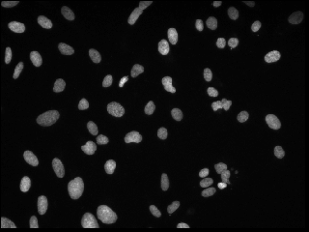
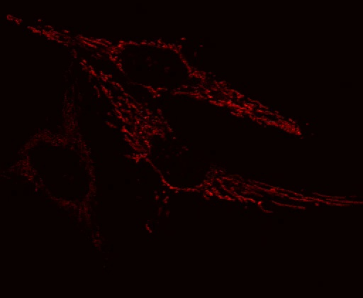
Background
Microscopy has lead to widespread biomedical image data
Many techniques have arisen to segment, track, and quantify this new data
These advances are too heavily focused on ‘solid’ structures like nuclei, or cell bodies
We aim to fill the gap in software focused on diffuse patterns induced by mitochondria or actin
Notes:
Left image is a set of nuclei intended for segmentation in the 2018 Kaggle Data Science Bowl. Right image is Mitochondrial protein pattern DsRed2-HeLa_3_15_LLO2part1

Slide 3
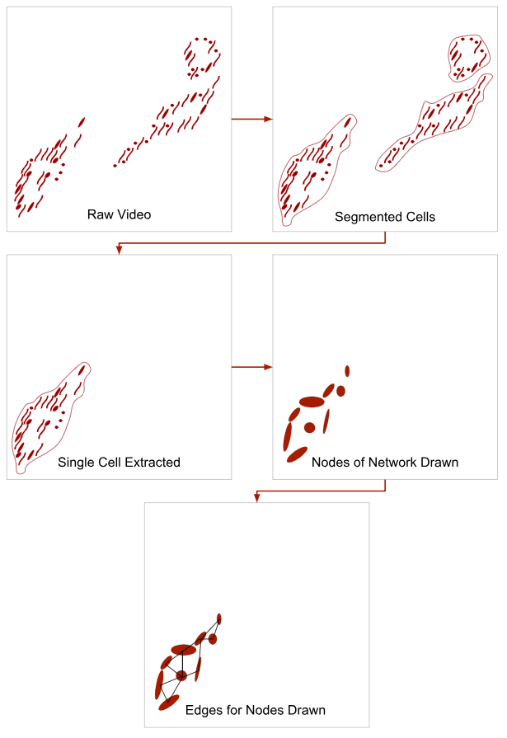
Pipeline
We aim to autonomously segment each cell
We apply a Gaussian Mixture Model to determine nodes of our network analogue
With nodes determined we apply a pseudo-distance metric to create an affinity matrix for the network
At which point we use network metrics to quantify the behavior of each protein structure

Slide 4
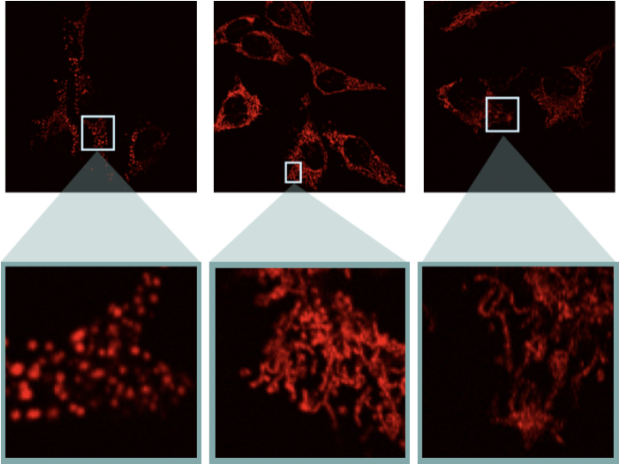
Mitochondrial Behavior
Our data consists of three categories
Wild Type: the natural topology of the protein structure
Fragmented: isolated high concentration areas induced by LLO
Hyperfused: a stringy fused together form of the wild type topology induced by mdivi-1
These are the categories on which we condition our network analysis

Slide 5
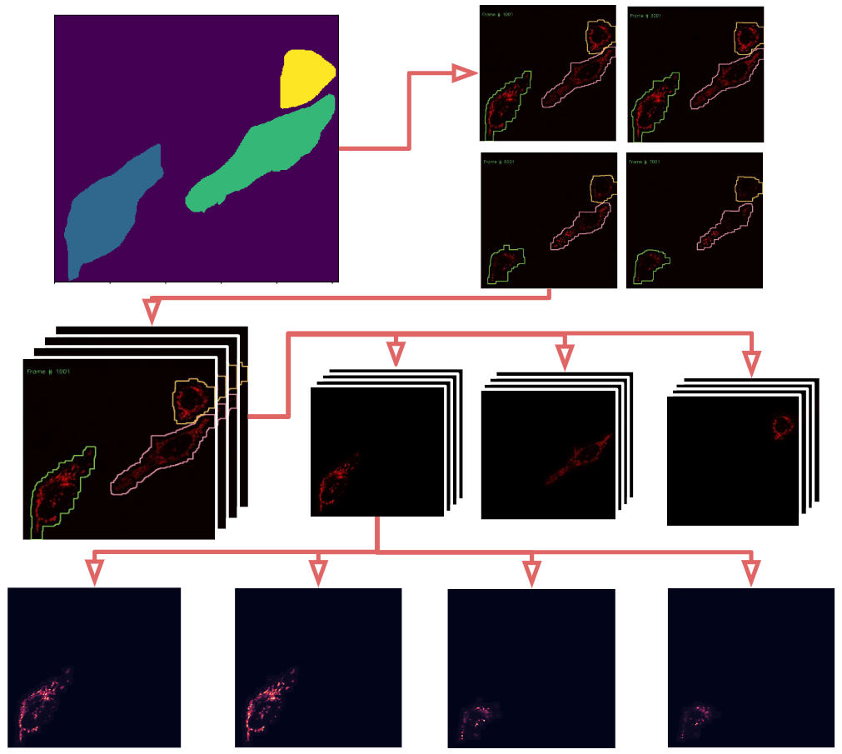
Segmentation
To avoid bias we separate each cell
Due to the diffuse structure and tight region boundaries we primed the segmentation process with hand drawn masks
Using a iterative process of dilation and erosion of each mask we deform each mask to follow each cells morphological changes
This process outputs cell masks for each frame which allow us to pull out a single cell for network fitting.

Slide 6
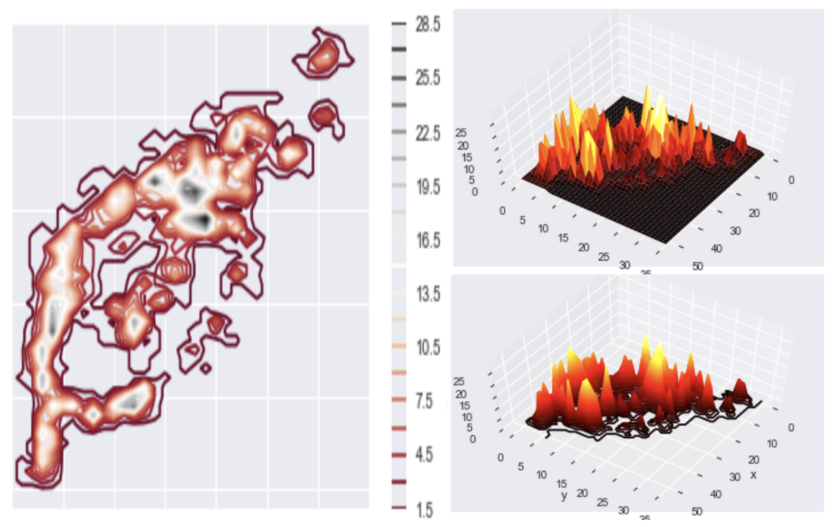
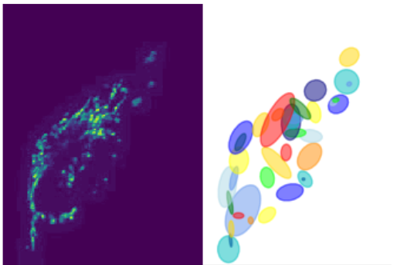
Mixture Model
Finds nodes to characterize the locale of mitochondria within the structure
We determine the number of nodes by counting local maxima of the image
We convert each cell to a discrete probability distribution
We then fit SciKit Learn’s Gaussian Mixture Model to our image
Each component becomes a node
Each frame is then fit by the GMM using the previous frame’s model parameters

Slide 7
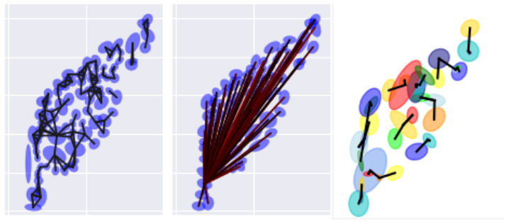
Affinity Functions
Early distance based metrics
Simple and quick
Doesn’t account for variance
Probability Based Metric
A -> B = A(μ(B))
Accounts for variance
assymetric
Kullback-Leibler Divergence
Psuedo-distance metric for probability distributions
assymetric
Jensen-Shannon Divergence
Based on KL Divergence
symmetric

Slide 8
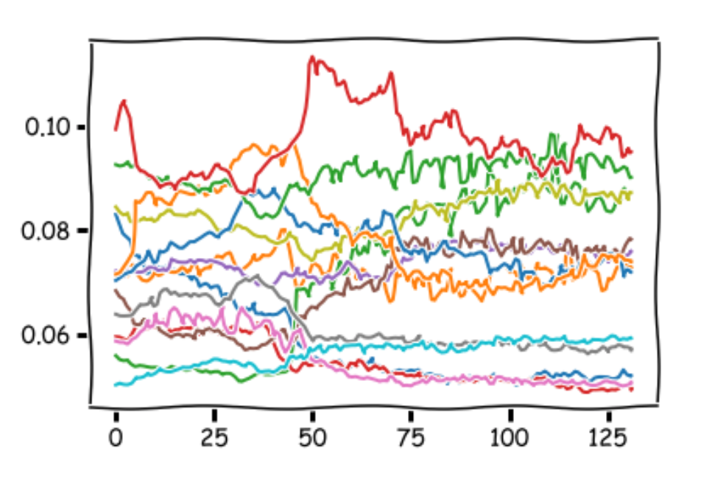
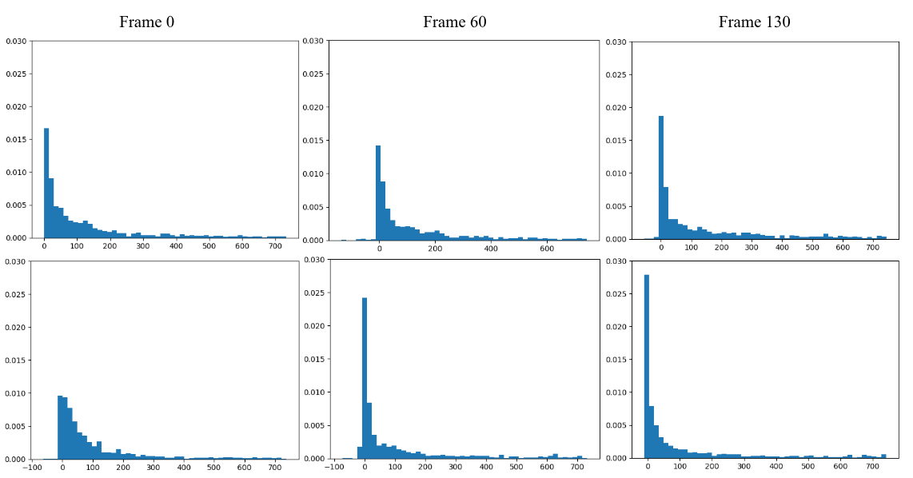
Network Analysis
Connectivity Based
Look at the number and weight of connections in the network
Eigen decomposition
Look at the eigenvalues of each eigenvector over time
Future work
Spectral Clustering
PageRank

Slide 9
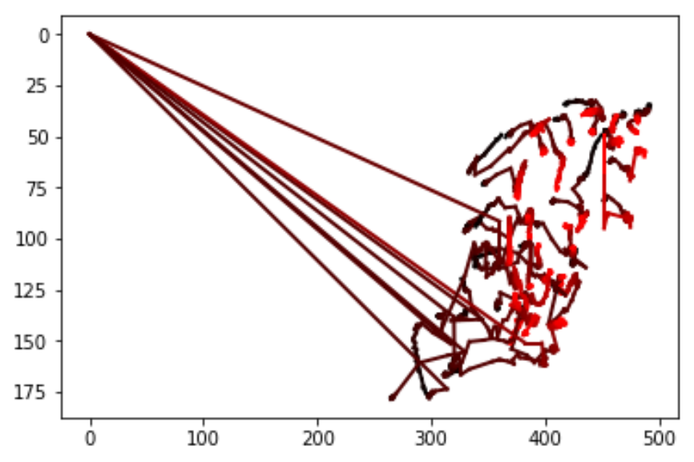
Conclusions and Future Work
We are able to infer some biological behaviors from properties of our network analogues
We intend to have a fully autonomous segmentation step
Powered by a Dense FCN
We are looking into the pros and cons of each affinity function
We are continuing forward with new forms of Network Analysis
We are working to implement our own Gaussian Mixture Model for Node determination

Slide 10
Thank You
Also Here is a link to the paper in the proceedings of SciPy:
http://conference.scipy.org/proceedings/scipy2018/Andrew_Durden.html

